Slide 1
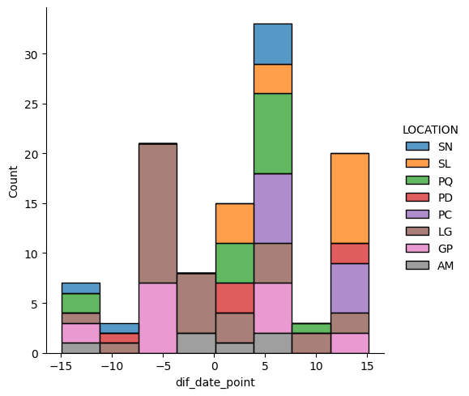
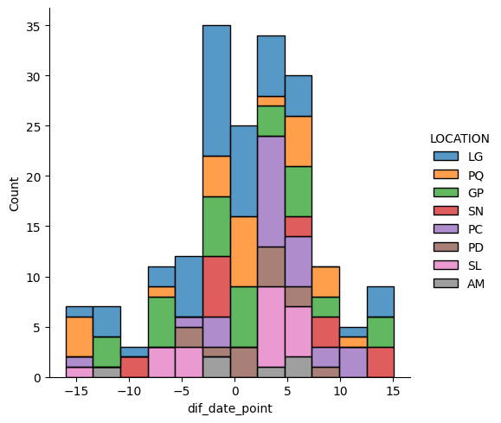
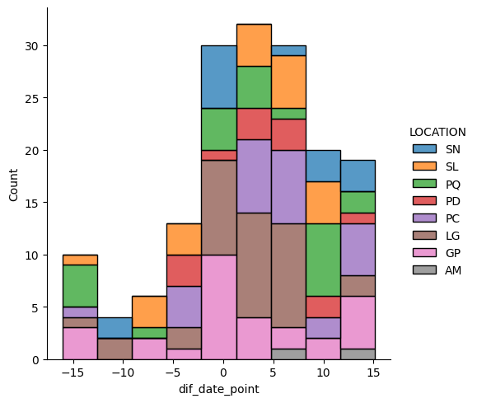
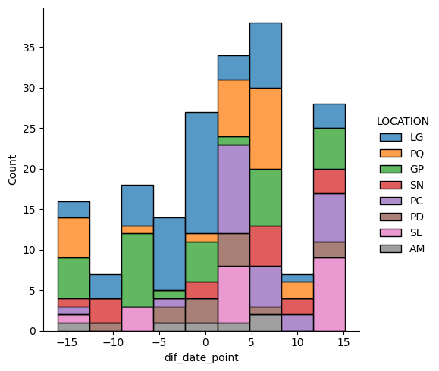
LD8
LD7 + LD8 min date diff
LD7 + LD8
LD8 priority
LD7

Slide 2
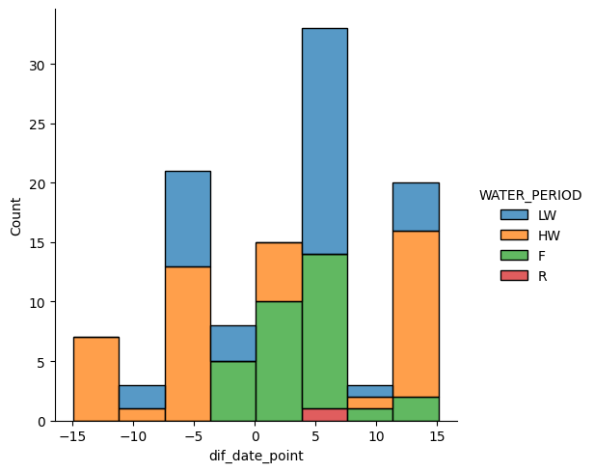
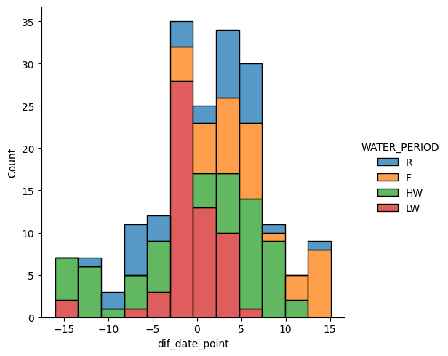
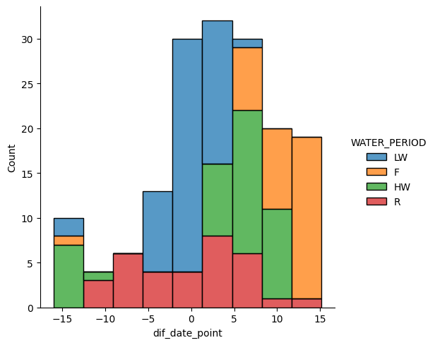
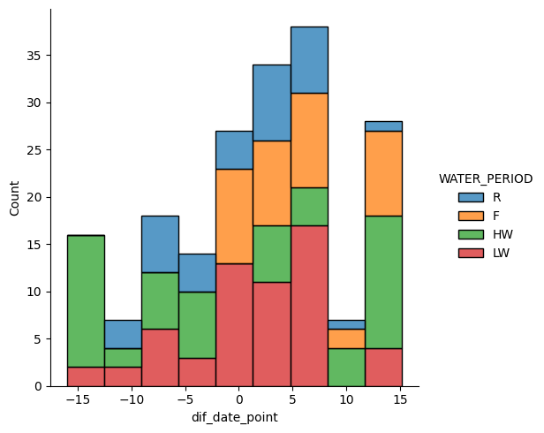
LD8
LD7 + LD8 min date diff
LD7 + LD8
LD8 priority
LD7

Slide 3
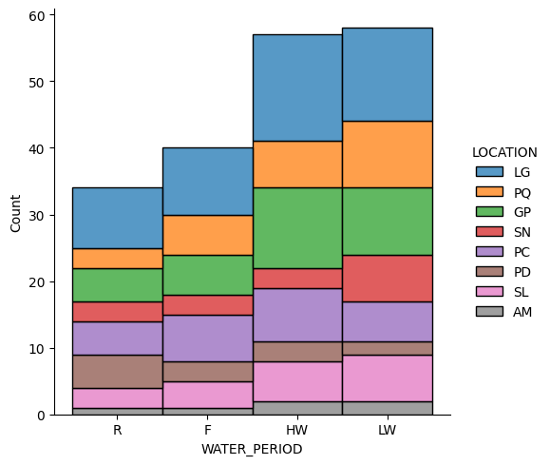
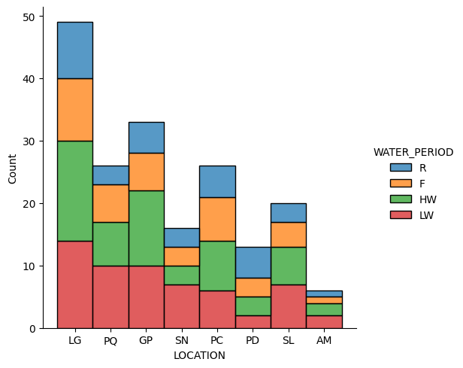
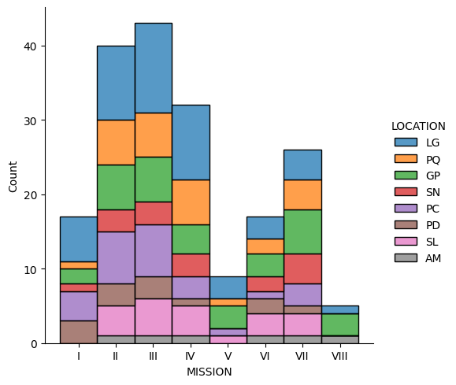
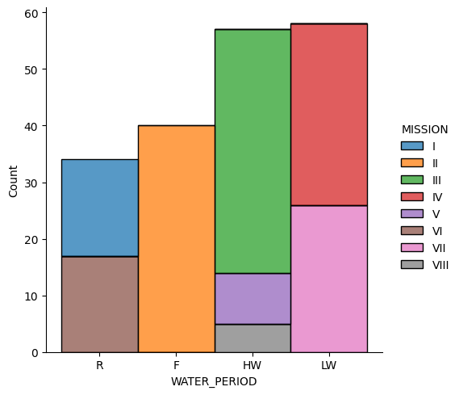

Slide 4
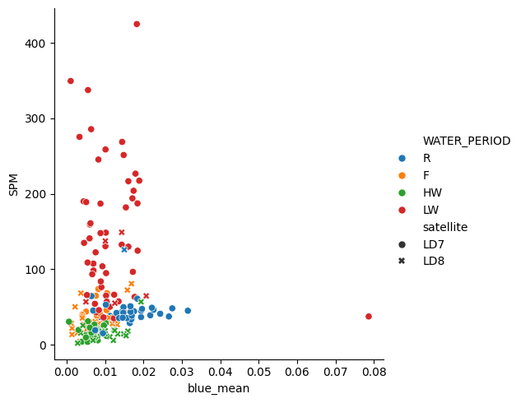
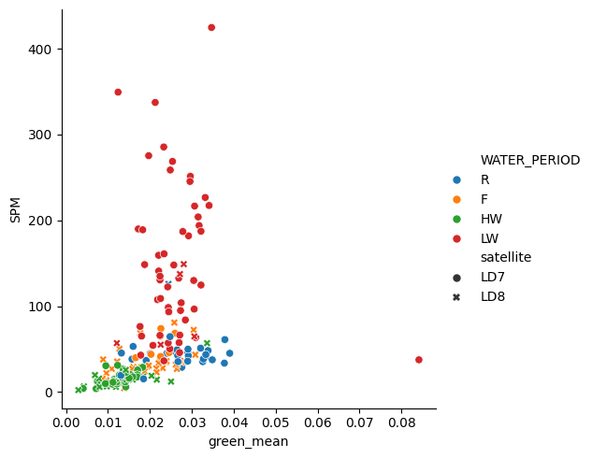
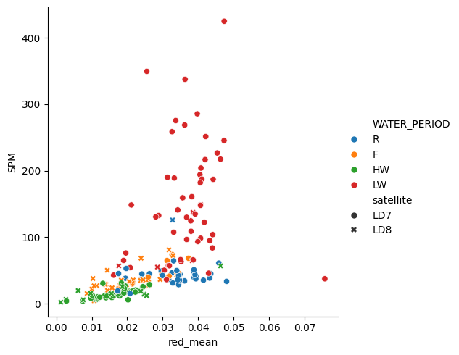
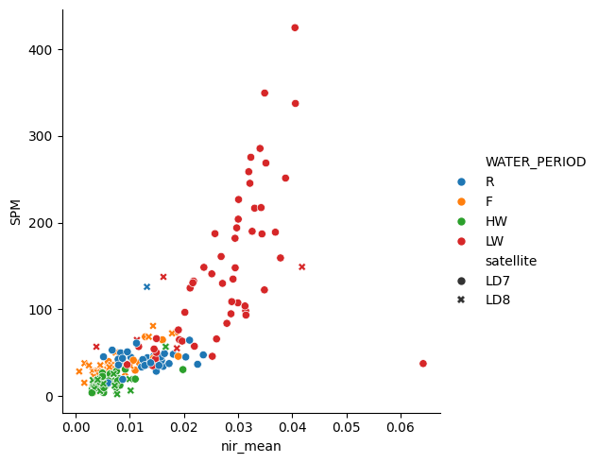
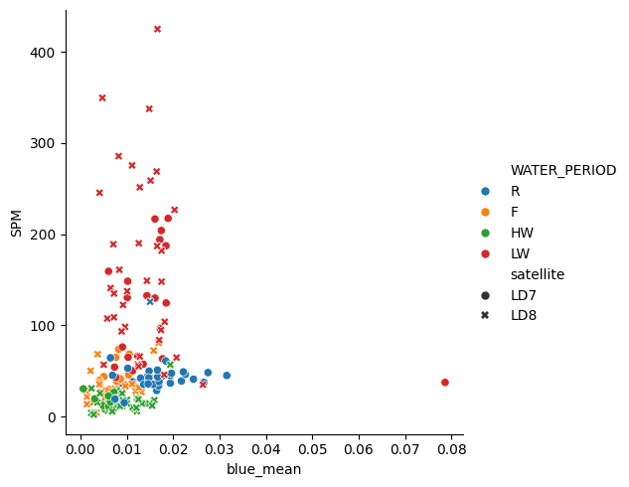

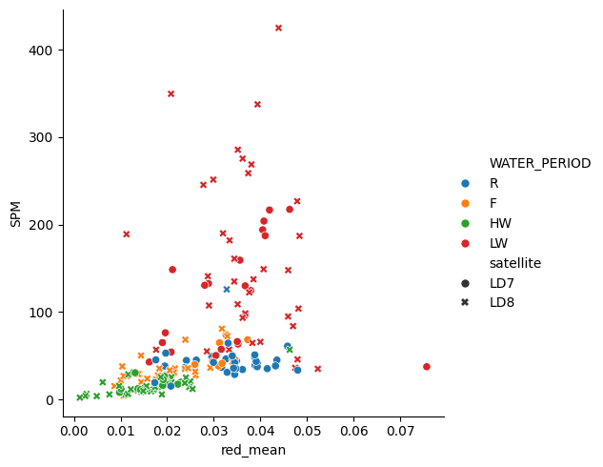
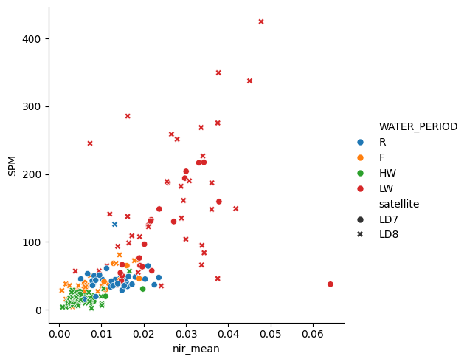
Menor diferença de data entre amostra e imagem
SPM vs média das bandas
Priorizar imagem LD8

Slide 5
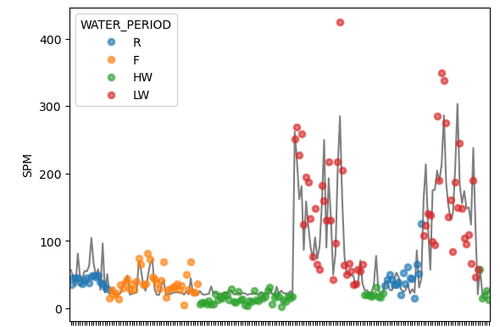
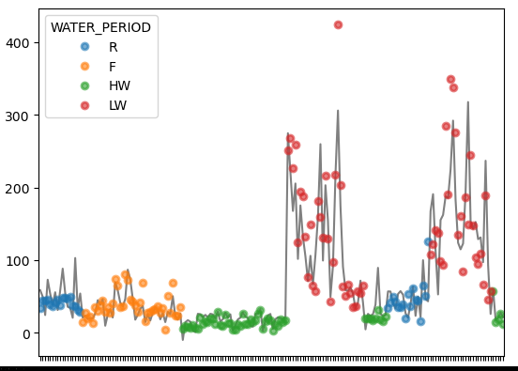
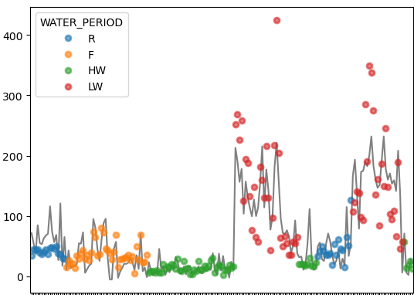
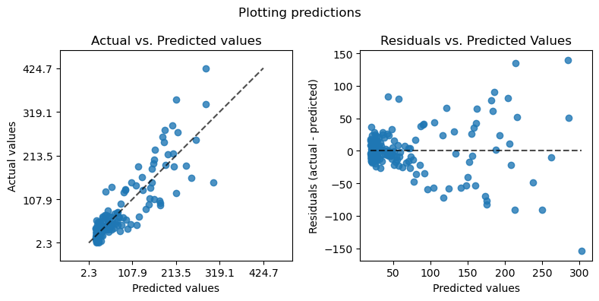
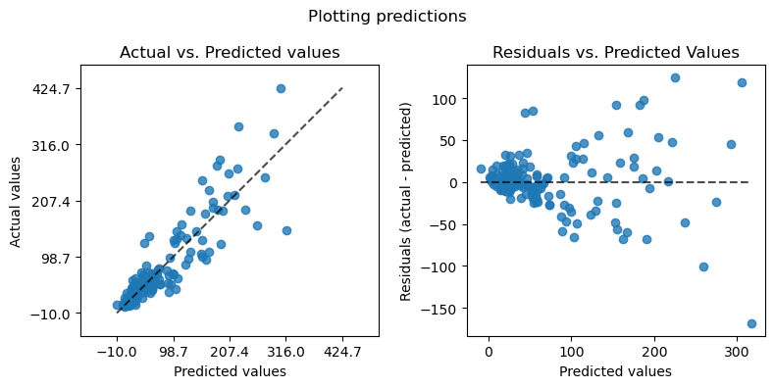
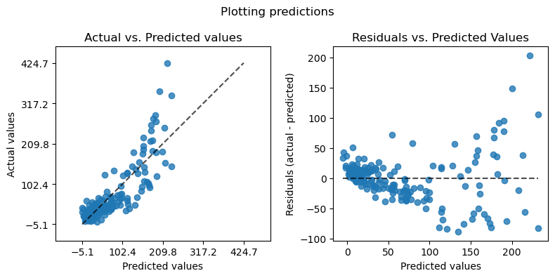
Polinomial NIR
Polinomial multipla
Linear multipla
CV Metrics:{'r2': 0.7275004892139136, 'mae': 24.756053348276176, 'mse': 1582.4350502615684, 'mape': 0.8235208096180718, 'exp_var': 0.7288761188754188}
Metrics:{'r2': 0.8067844304170517, 'mae': 19.678273162345402, 'mse': 1036.9933608650351, 'mape': 0.4190075349016725, 'exp_var': 0.8067844304170517}
Metrics:{'r2': 0.7312429382255918, 'mae': 25.662056294174953, 'mse': 1442.4266602697803, 'mape': 0.6272036469220751, 'exp_var': 0.7312429382255918}
Metrics: {'r2': 0.7834035765581147, 'mae': 21.709839272638554, 'mse': 1162.4790568439223, 'mape': 0.5680294729945504, 'exp_var': 0.7834035765581147}
CV Metrics:{'r2': 0.6653793185224794, 'mae': 25.027625604567344, 'mse': 1915.711839000988, 'mape': 0.5360761898233042, 'exp_var': 0.6705767878863748}
CV Metrics:{'r2': 0.6868549637009771, 'mae': 28.55208919404135, 'mse': 1941.1954995246676, 'mape': 0.86239106915262, 'exp_var': 0.6949382278716765}

Slide 6
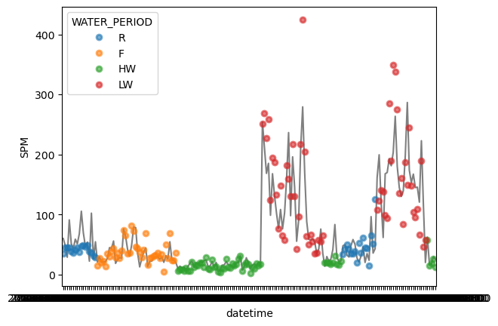
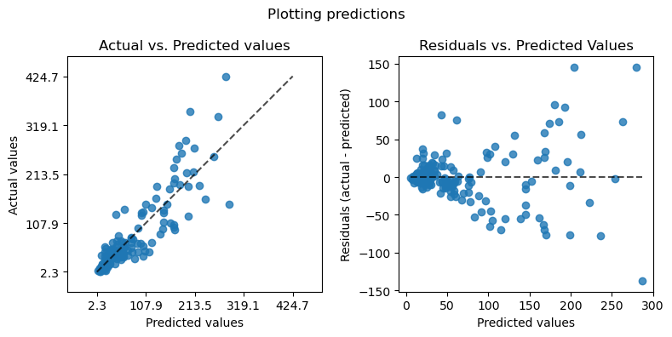
KRR
CV Metrics:{'r2': 0.7309091479866278, 'mae': 21.97078487403672, 'mse': 1462.8693110733564, 'mape': 0.44418840250309427, 'exp_var': 0.7335229584071823}

Slide 7
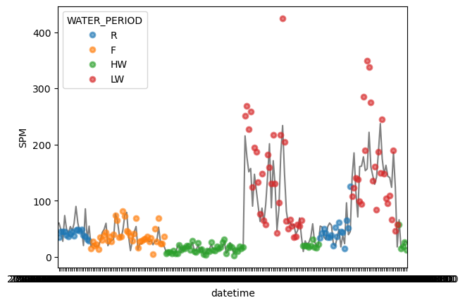
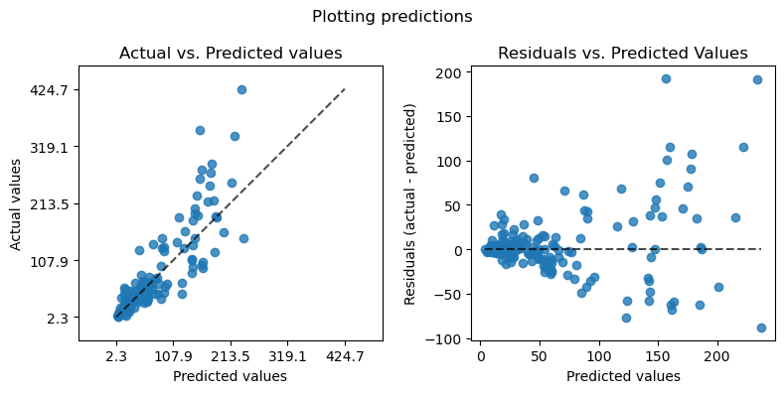
CV Metrics:{'r2': 0.7185833542906258, 'mae': 21.87422618888653, 'mse': 1617.0868765550244, 'mape': 0.3732960566832173, 'exp_var': 0.7296991121519386}
SVR

Slide 8
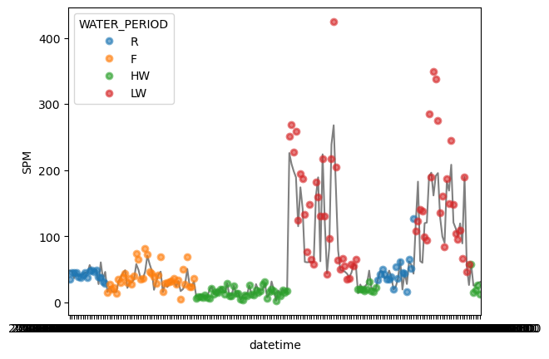
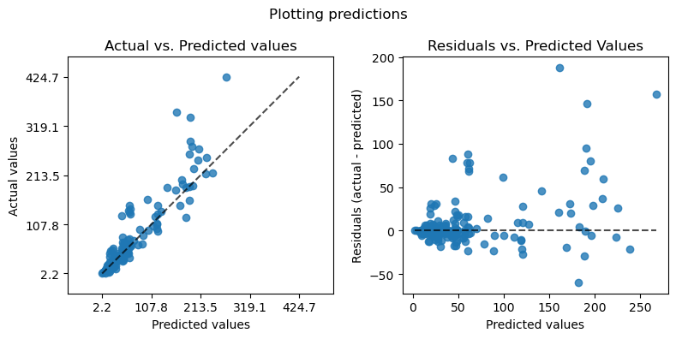
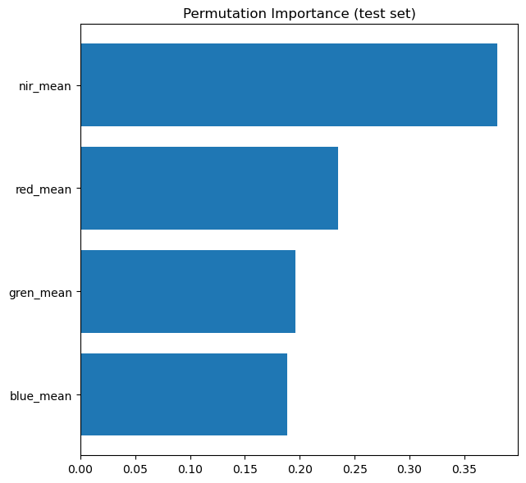
CV Metrics:{'r2': 0.6880753044438264, 'mae': 21.49688050964428, 'mse': 1712.2022301757004, 'mape': 0.4466926976345441, 'exp_var': 0.7073890085589009}
GBDT

Slide 9
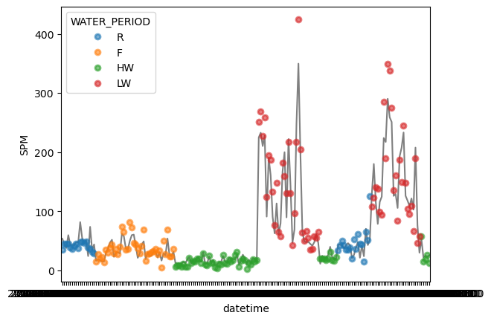
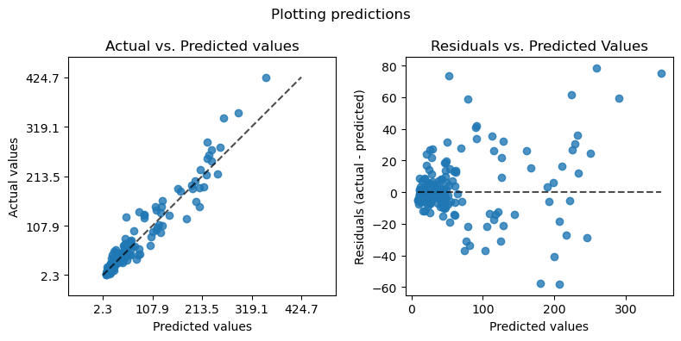
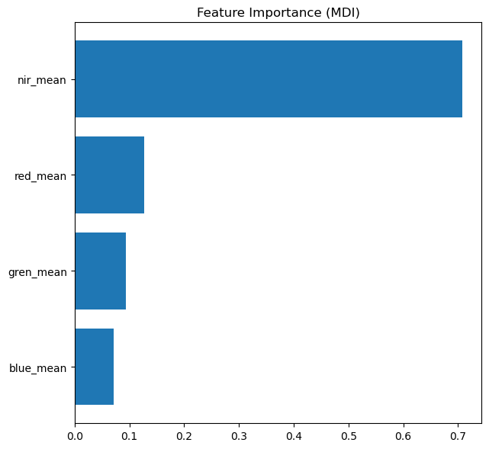
CV Metrics:{'r2': 0.7427629283601322, 'mae': 21.70488302453932, 'mse': 1441.4981086375294, 'mape': 0.487806367547315, 'exp_var': 0.7483816367203783}
RF

Slide 10
Inserir modelo Nechad e outros necessários

Slide 11
Github links to view more data: https://github.com/larissavaladao/py6s_harmonize_sample/

